Slide 1





‘Calm, Cool & Collected’
Selecting the right sensor for Hazardous Environments
Sponsored by:
Everight Position, POSTIAL and Positek

Slide 2
Overview
What is a ‘Hazardous Location (HazLoc)’
How are devices made to operate in a Hazardous Location
Intrinsically Safe
Explosion Proof
Sensors developed for HazLoc
Q+A
Disclaimer: Final decisions on products in a hazardous location must be made by a Safety Engineer who has complete knowledge of the entire location.

Slide 3
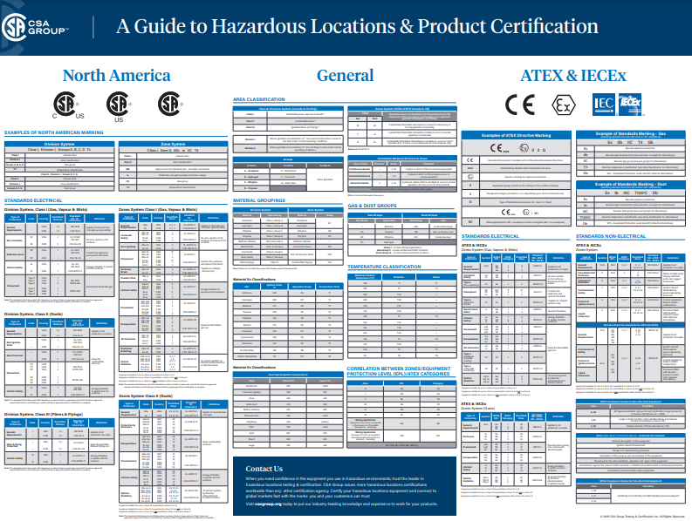
Designing Systems In a ‘Hazardous Location’
Dangerous?
Confusing?
Overwhelming?
Humbling?

Slide 4
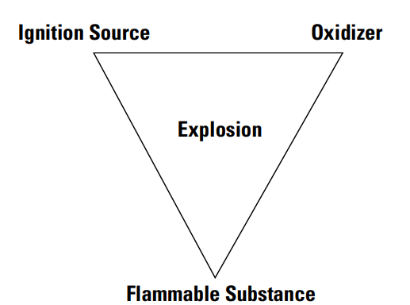
What is a ‘Hazardous Location’
“Hazardous areas exist where a potentially explosive mix of air and flammable gasses or air and dust or air, dust and gasses may occur.”
Chemistry 101
To cause a reaction you need:
Fuel
Oxygen
Ignition Source
Image credit

Slide 5
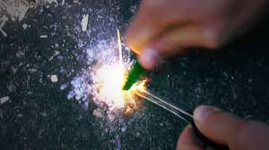
Potential Ignition Sources
Open flames
A lit cigarette to welding sparks
Lightning strikes
Impact sparks
ie. Hammer blow on a rusty surface vs hammer blow on a flint stone
Mechanically generated friction sparks
Electrical sparks
Electrostatic discharge
High surface temperature

Slide 6
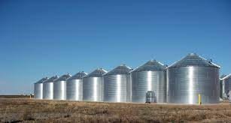
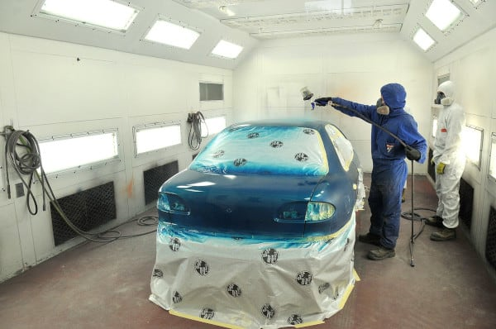

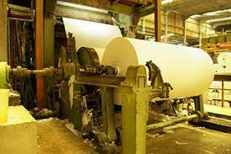
HazLoc’s Are Common
Could be a:
Chemical refinery
Fuel station
Paint booth
Mining
Coal dust
Agriculture
Grain mills, sugar refineries, silos
Printing industries, paper and textiles
Sewage treatment plants
And the list goes on…

Slide 7
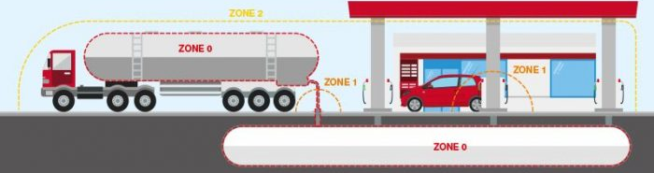
HazLoc
Zone 0
Explosive atmosphere is present continuously for long periods of time or will frequently occur.
Zone 1
Explosive atmosphere is likely to occur occasionally in normal operation. It may exist because of repair, maintenance operations, or leakage.
Zone 2
Explosive atmosphere is not likely to occur in normal operation but, if it does occur, will persist for a short period only.
These areas only become hazardous in case of an accident or some unusual operating condition.
Image credit: heatingandprocess.com

Slide 8
Devices – Intrinsically Safe
Can’t remove the fuel, so engineers remove the ignition source
Intrinsically Safe (IS)
An IS device is “incapable of releasing sufficient electrical or thermal energy under normal or abnormal conditions to cause ignition of a specific hazardous atmospheric mixture in its most easily ignited concentration”
Accomplished in IS devices by limiting the amount of power to be below the level that will ignite the atmosphere

Slide 9
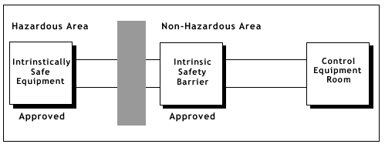
Devices – Intrinsically Safe
Most commonly an IS barrier is wired in series with the device
The barrier is located in a ‘safe zone’ outside of the explosive atmosphere
Barriers typically use
Zener Diodes to limit voltage
Resistors to limit current
Fuse
Temperature must still be considered
Omega link

Slide 10
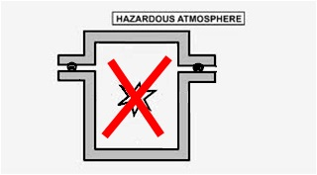
Devices – Non-Sparking
Design prevents sparking or excess temperatures under normal circumstances
Designed for least stringent environments
Explosive atmosphere is not usually present

Slide 11
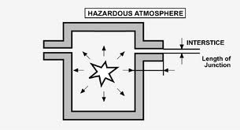
Devices – Flame-Proof
An explosion occurring inside encoder will not propagate to environment

Slide 12
Devices – Explosion Proof
Can’t remove the fuel, so engineers contain the ignition
‘Explosion Proof’
If an explosive atmosphere penetrates into an enclosure and a trigger is produced; the explosion occurs, but it remains confined within the enclosure
Does not allow the spread of flame to the surrounding atmosphere
External temperature of the housing will not get hot enough to ignite vapors in the area
Enclosures must be constructed with
Mechanical strength such as to contain the overpressure caused by the explosion
Allow the escape of flue gases (flame path)
Allows the gases to exit the enclosure and to cool down during the passage, so that they are no longer able to trigger the outside atmosphere
https://www.cortemgroup.com/en/about-ex/technical-articles/evolution-ex-proof-flame-path

Slide 13
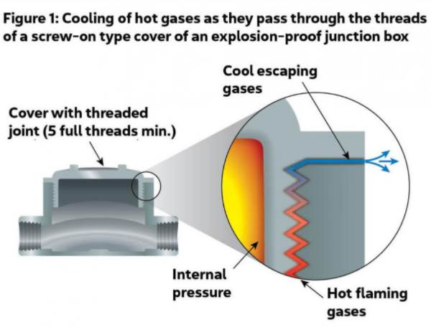
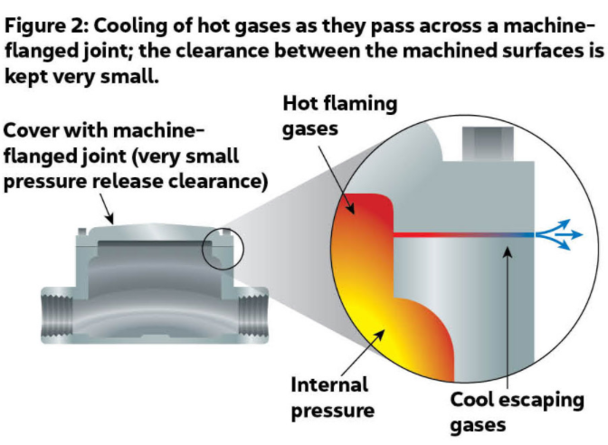
Devices – Explosion Proof
Since Ex Proof devices are largely mechanical changes, communicating with them is similar to industrial devices
No additional barrier as for IS devices
Analogous devices for ‘safe’ environments are often available
Reduce cost and overall system complexity
Image Credit: National Electrical Code Handbook, 2017 Edition

Slide 14
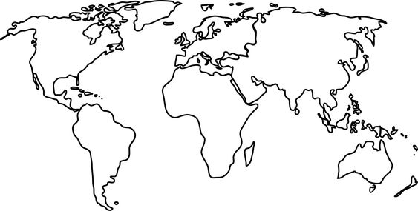
Regulatory
ATEX
IECEx
CCC
CSA
UL

Slide 15
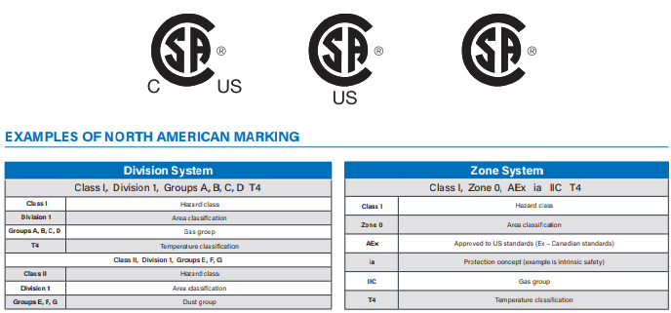
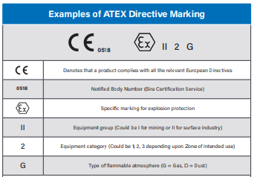
Labeling
North America
Europe

Slide 16
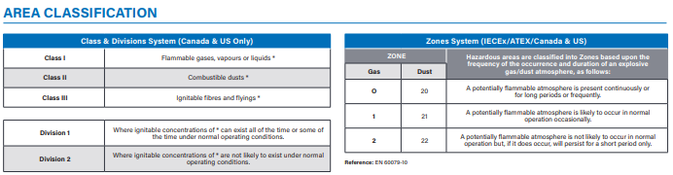
Labeling
Ability to use ATEX in N. America and use UL/CSA in Europe is often a case-by-case decision for the safety engineer for the project
More on Class+Div VS. Zone https://www.ul.com/services/ul-and-c-ul-hazardous-areas-certification-north-america

Slide 17
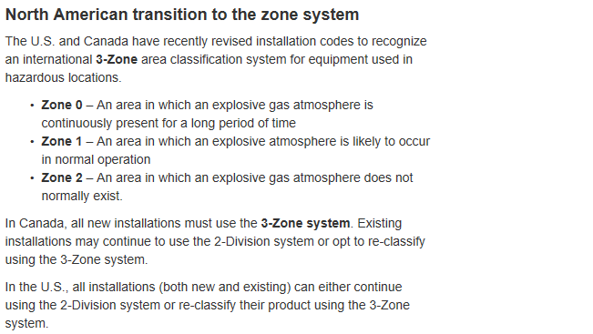
Labeling – Class+Div VS Zone

Slide 18

Sensors
Broad variety of sensors on the market for use in hazardous environments
Rotary
Tilt
Linear
Temperature
Pressure
etc

Slide 19
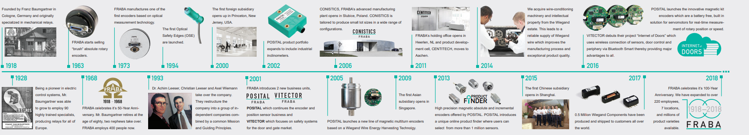
POSITAL
Founded in Germany in 1918
Growing global presence in last 20 year
Focus is on elimination of active ignition source

Slide 20
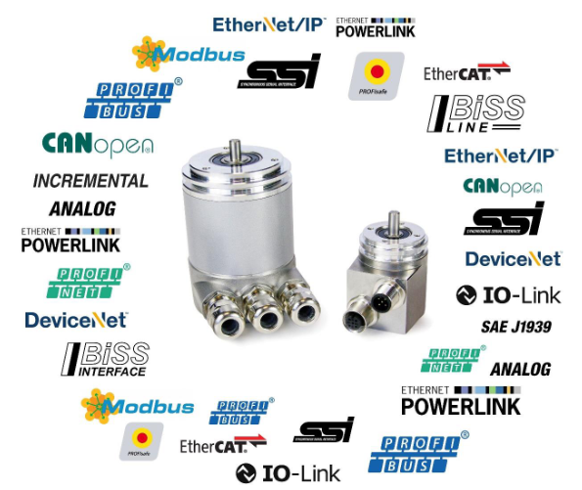
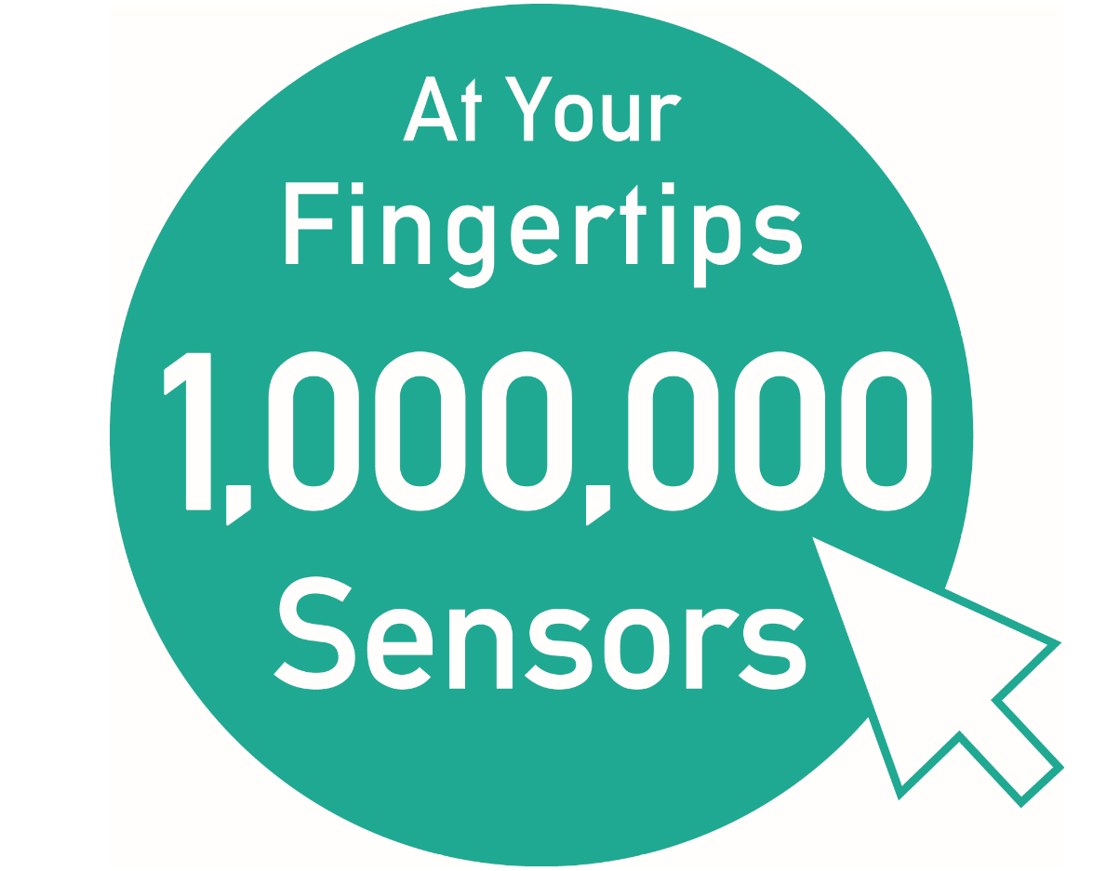
POSITAL - Products
Rotary encoders and inclinometers
Large Variety of the Ex-Products
Universal Compact Mechanical Designs
Easy Application Installation
Products with Global View of the Regional Ex-Certification

Slide 21
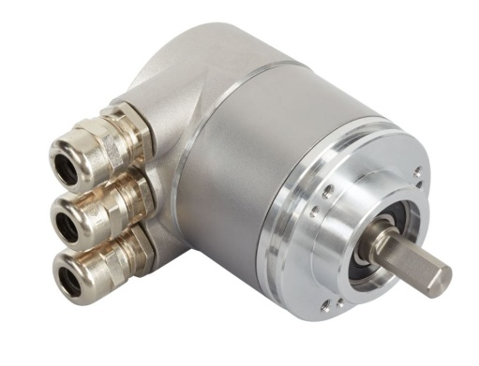
POSITAL - Approach
Non Sparking Type “nA”
Design prevents sparking or excess temperatures
Seals
Glands
Produced by only trained workers
Dedicated for:
Zone 2 & 22
Div. 2 Class I
Certification:
Manufacture Self-declaration ATEX
Profinet Encoder for Div.2 Class I
Future:
3rd party certification for ATEX/IECEX*
Extend UL/CSA for Div. 2 class I/II*
CCC – China*
*Certification project in progress

Slide 22
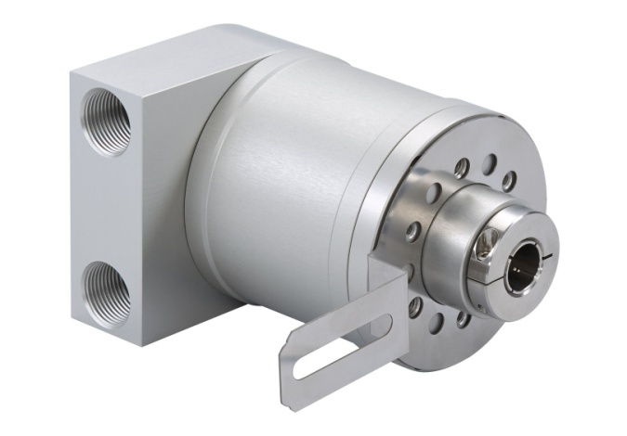
POSITAL - Approach
Flameproof Enclosure Type “d”
An explosion occurring inside encoder will not propagate to environment
Thicker housings
Flame paths
Certification:
ATEX & IECEx
Future:
CCC – China*
Dedicated for:
Zone 1 & 21
Underground Mining

Slide 23

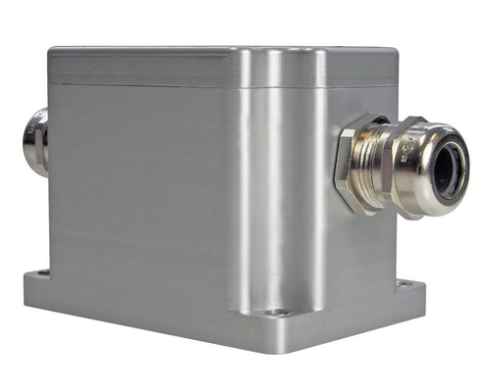
POSITAL - Approach
Only MEMS based ATEX inclinometer in the world
Encapsulation type “m”
Keeps the potentially explosive atmosphere away from the source of ignition
Certification:
ATEX & IECEx
Future:
CCC – China*
Dedicated for:
Zone 1 & 21
Underground Mining
*Certification project in progress

Slide 24
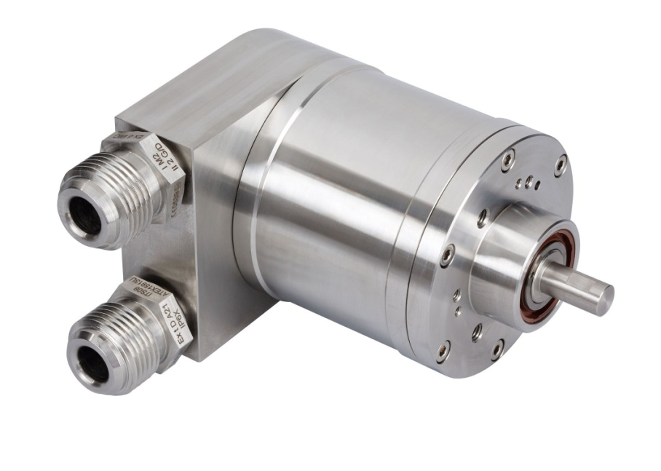
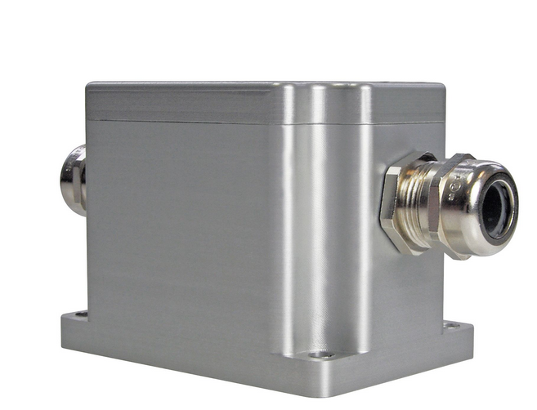
Posital – Product Highlights
ATEX/IECEx/ULCertification Available
Available with Ethernet, Digital, Analog and Incremental Interfaces
No Battery Backup
Removable Connection Cap Or Cable Exit
Group I And Group II Certification
Zone 1 (Gas), 21 (Dust) And 2 (Gas), 22 (Dust)
High Resolution Up To 16 Bit And Revolution 14 Bit
Incremental Encoders Programmable
Available Also in V4A Stainless Steel
Project Customization Possible

Slide 25

Positek
Founded in the UK in 1992
Part of VariOhm/Discoverie
Focus of HazLoc products is on Intrinsic Safety

Slide 26
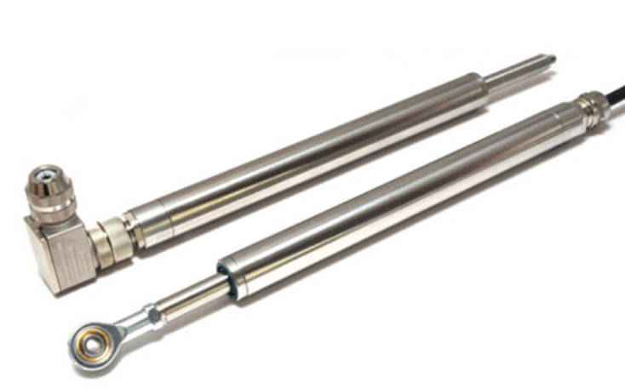
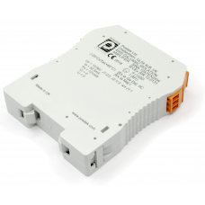
Positek - Products
Short stroke linear (< 1 meter) are dominant products
Also rotary encoders and inclinometers
Large Variety of the Ex-Products
Short lead times
4 weeks standard
1 week expedited
Hazardous Area
Safe Area

Slide 27
Positek – Intrinsically Safe
All Positek HazLoc products rely on the use of:
Galvanically isolated amplifier barrier
Located in safe area
Limits electrical and thermal energy into the hazardous area
0.5->4.5V output ratiometric circuit
Barrier can output voltage or current signal
Optional 5 wire installation
Negate the effects of loss over the wires and thermal effects
Up to 1,000 m between barrier and sensor

Slide 28
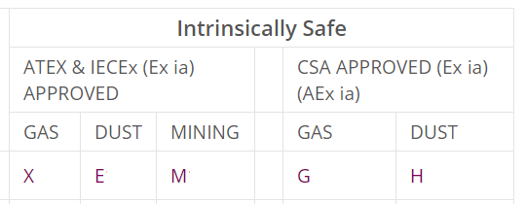
Positek – Environment Options
ATEX/IECEx approved to:
Ex II 1G
Ex ia IIC T4 GA (Ta = -40°C to +80°C)
Group II Category 1 G
CSA approved to:
Class I, Zone 0
Ex ia IIC T4 (Ta = -40°C to +80°C)
AEx ia IIC T4 (Ta = -40°C to +80°C)

Slide 29
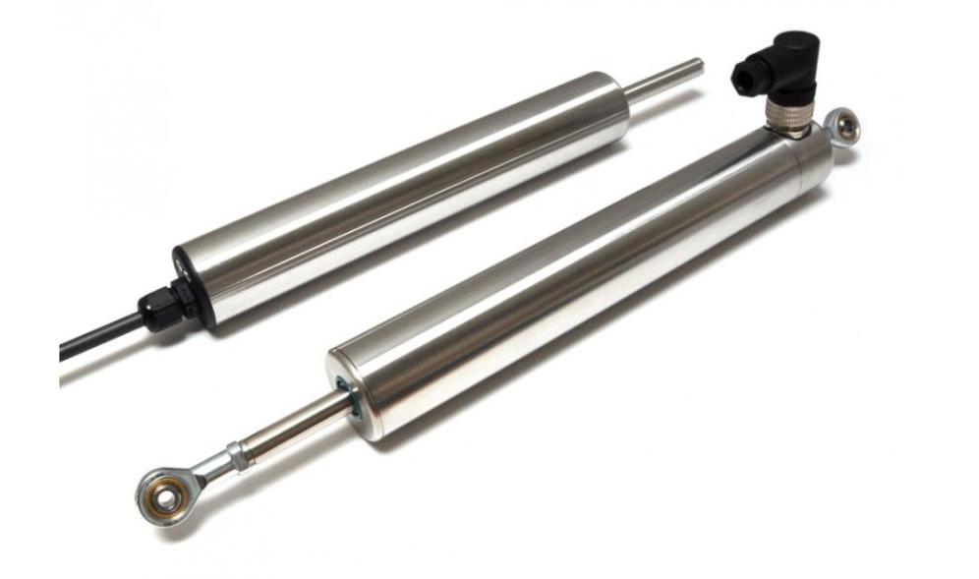
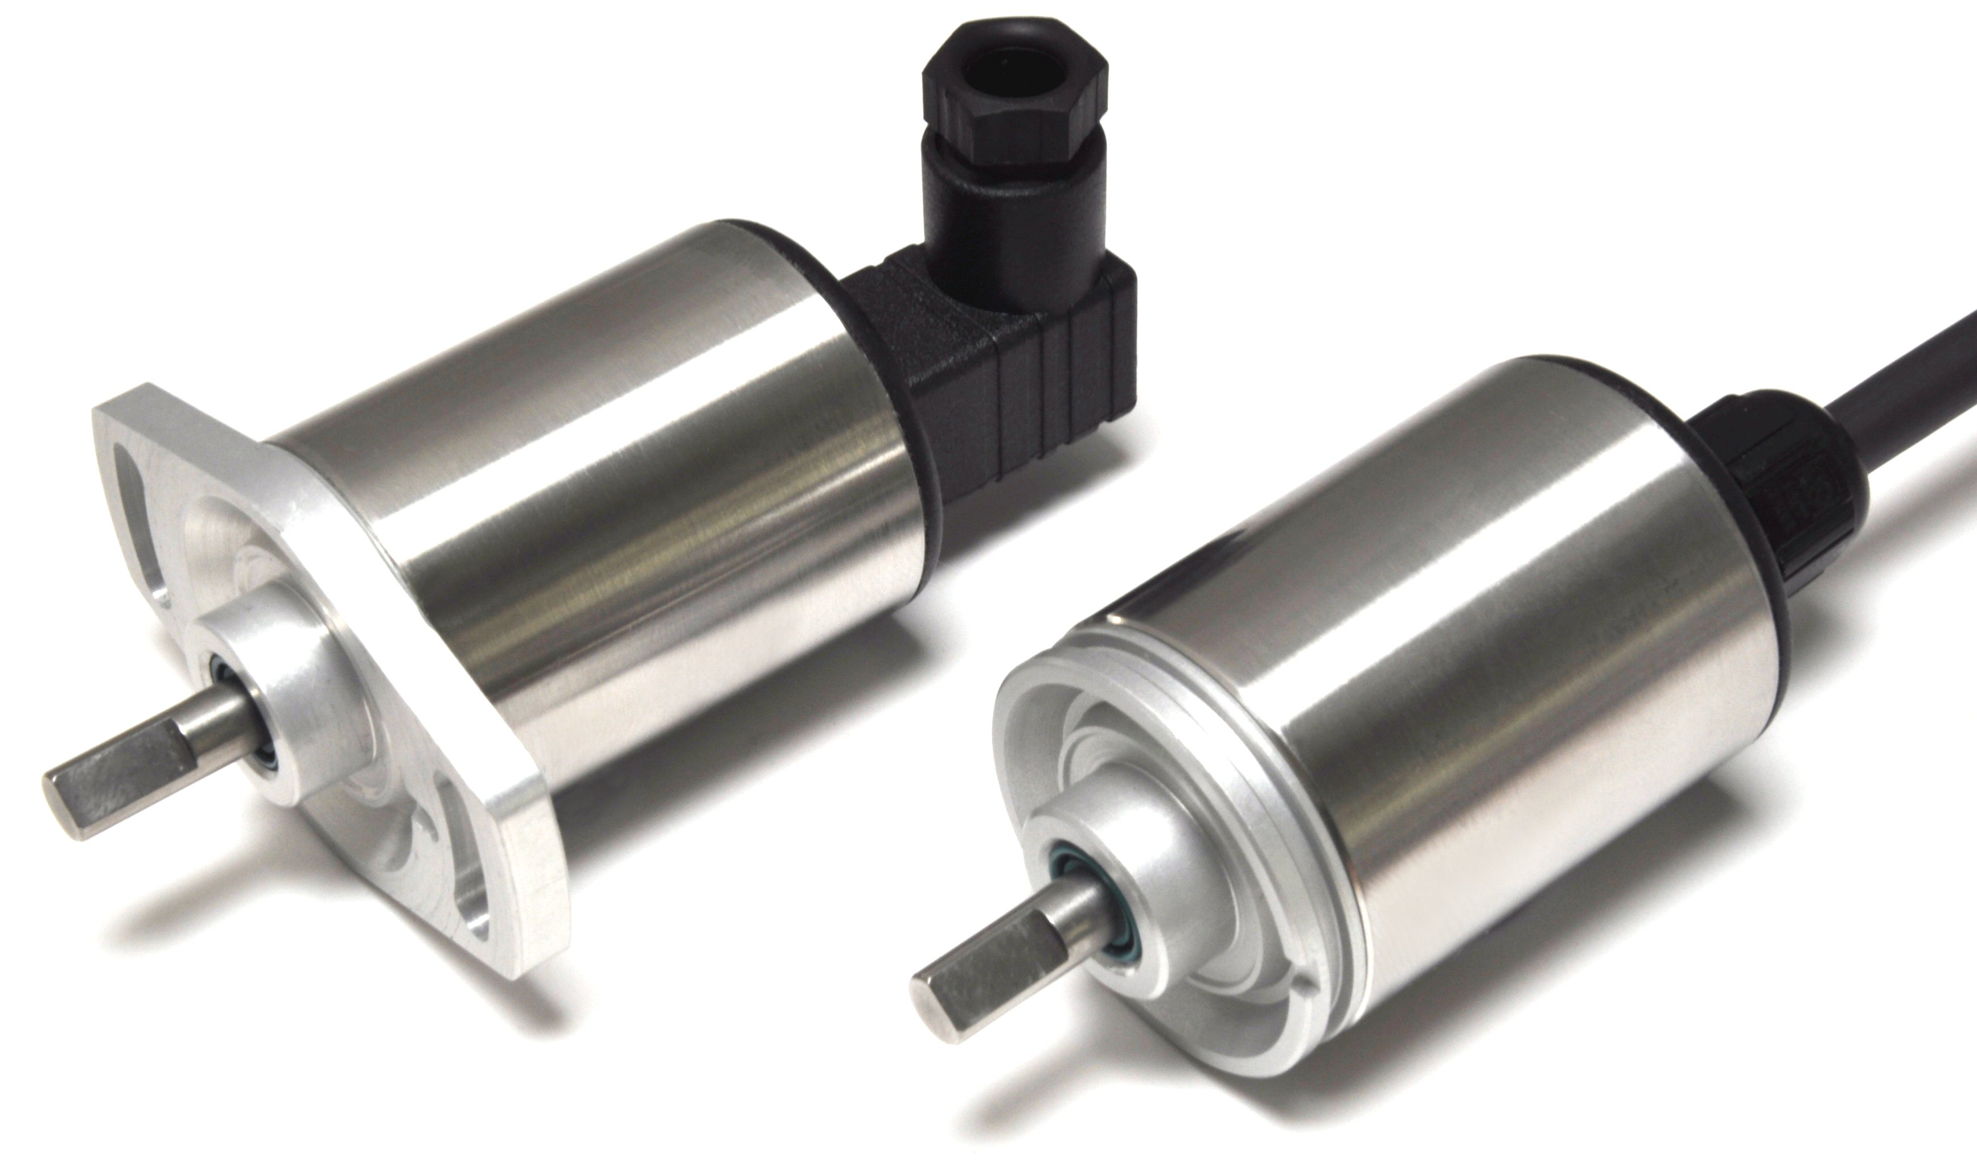
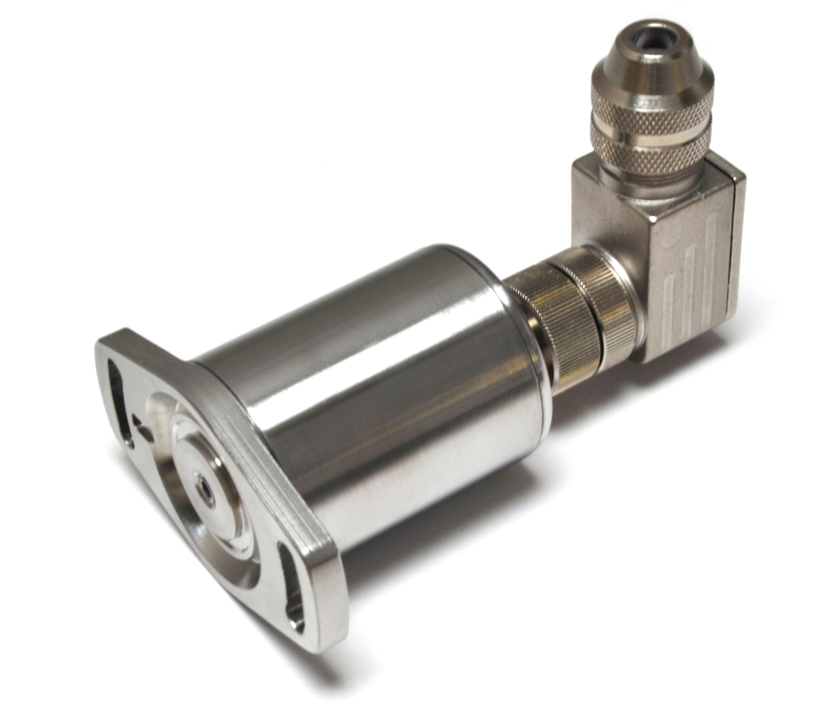
Positek – Product Series
Linear Position Sensors
Rotary Position Sensors
Tilt Position Sensors
Applications :
Paper manufacturing
Power turbines
Hydraulics
Offshore rigs
Applications :
Automotive
Industrial control
Valve control
Applications :
- Industrial machinery
- Vehicles, planes & marine

Slide 30
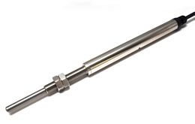
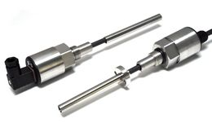
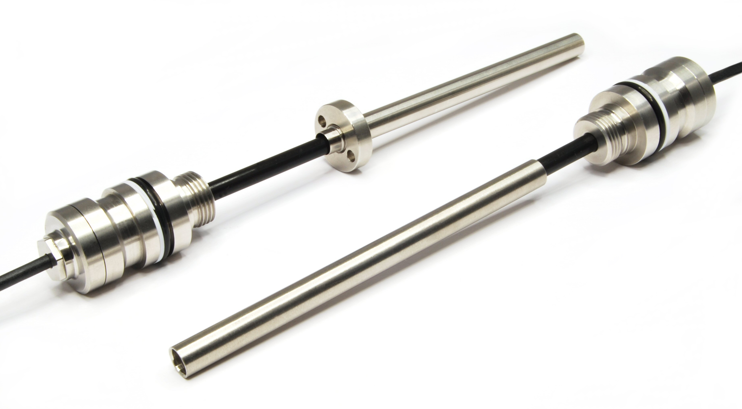
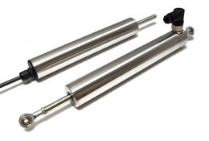
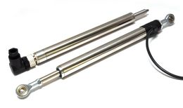
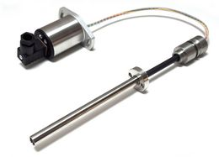
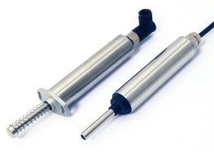
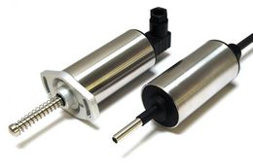
Positek - Linear
_100 Linear-Cylinder Position Sensor
_101/111 Stand Alone Linear Position Sensor
_106 Internally Mounted Cylinder Sensor
_103/133 Linear Sensor
_112 Gauge Head Linear Position Sensor
_116 Internally Mounted Cylinder Sensor
_117 Slim Line linear Position Sensor
_118/138 Slim Line Linear Sensor
_130 Long Stroke In- Cylinder Sensor

Slide 31

Thank you
Thank you to
Wojtek Pajak of POSITAL
Mark Spreadbury of Positek
You for joining us
For more info
Jarrod Orszulak
Everight Position
jarrod@evrtp.com
www.evrtp.com
856 727 9500

